Slide 1
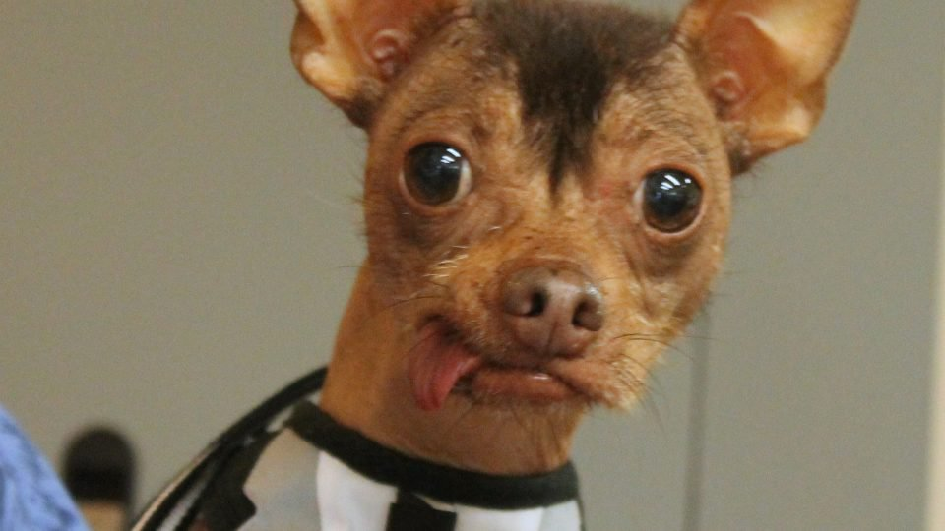
What’s going on in that mouth? Dental Anomalies
By: Sally Wiedeman, EPDH, MBA

Slide 2
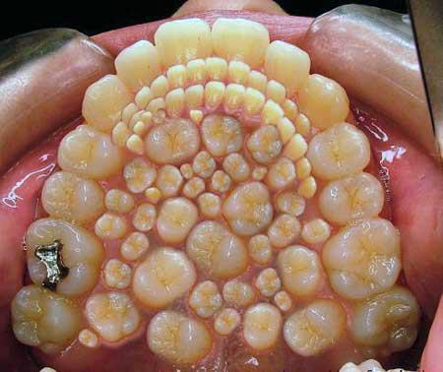
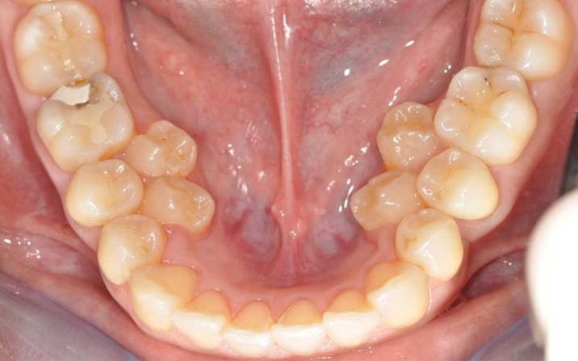
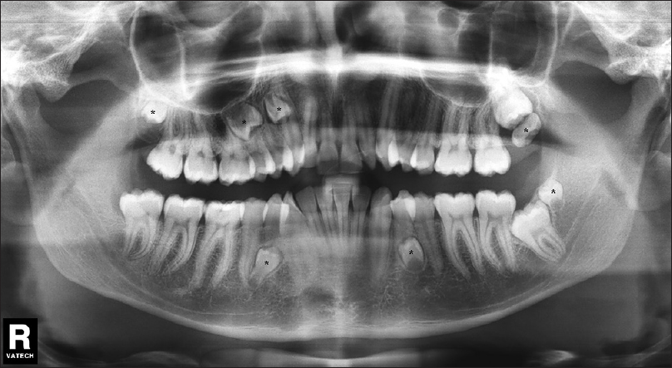
Hyperdontia or Supernumerary

Slide 3
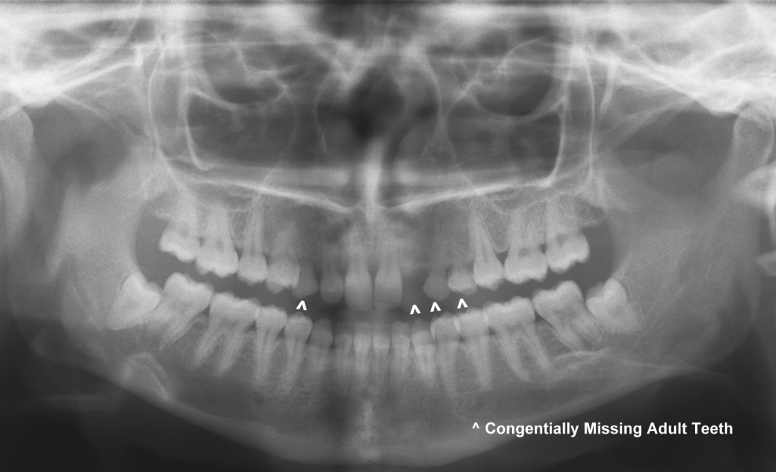
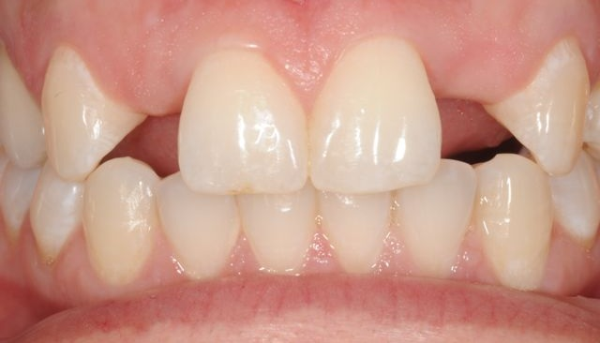
Anodontia or Congenitally Missing Teeth

Slide 4
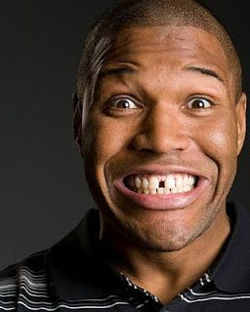
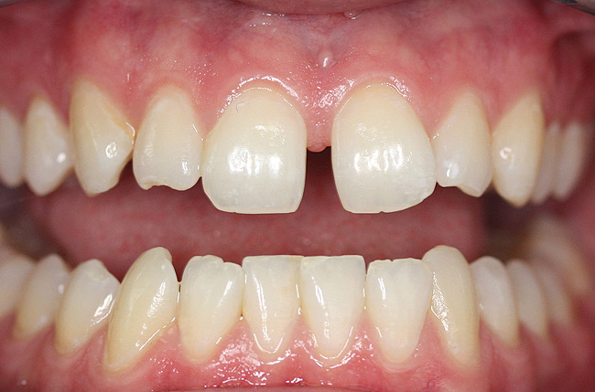
Diastema

Slide 5
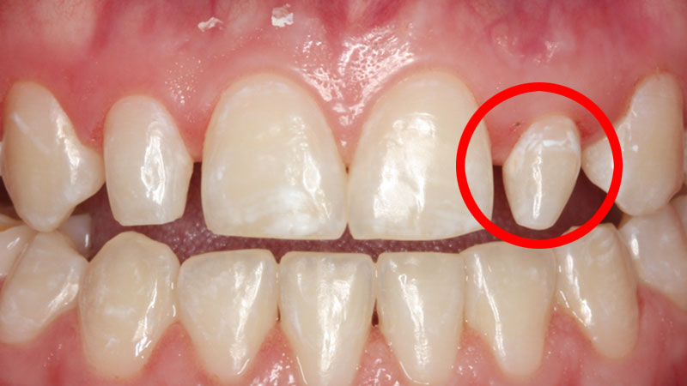
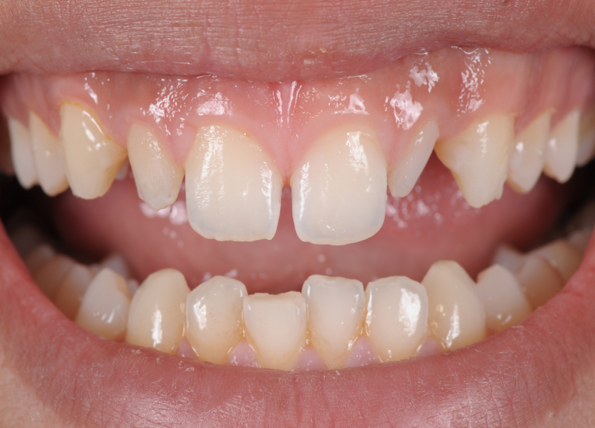
Peg Laterals

Slide 6
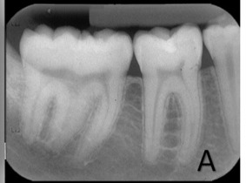
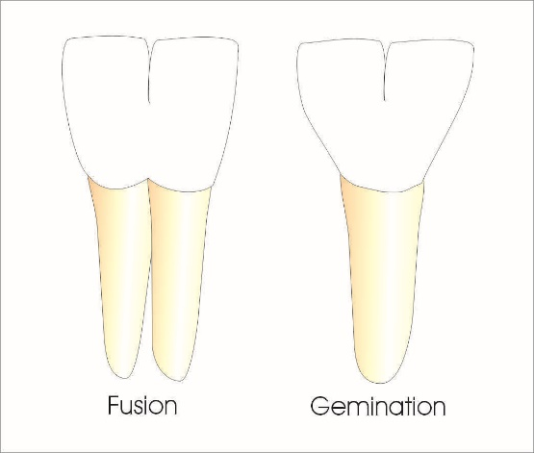
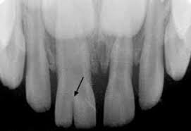
Fused & Geminated Teeth
Fused
Gemination

Slide 7
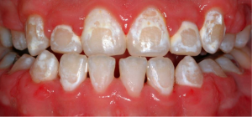
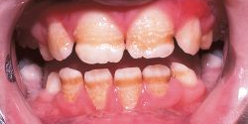
Enamel Defects
Decalcification
Hypocalcification
Hypercalcification
Notes:
Decalcification-enamel is disrupted during the remineralization process from our saliva
Hypocalcification-defect in the enamel caused by insufficient amount of minerals, either in a baby or permanent tooth
Hypercalcification -occurs when there's too much calcium in your enamel, sometimes caused by an infection during tooth formation

Slide 8
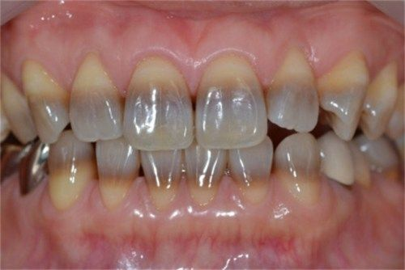
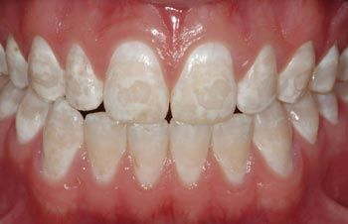
Intrinsic Staining
Fluorosis
Tetracycline
Notes:
Tetracycline caused by too high of dose or taking tetracycline multiple times during tooth development-drug becomes calcified in the tooth-in utero until the age of 8.
Fluorosis caused by ingesting to high of dose of fluoride during permanent teeth development, before eruption, birth-8 y/o, cannot get fluorosis after age 8

Slide 9
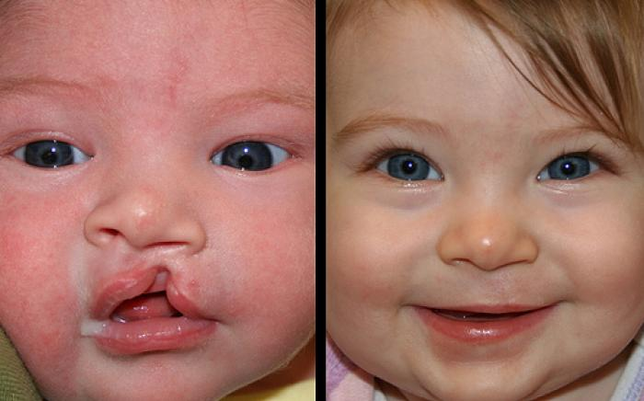
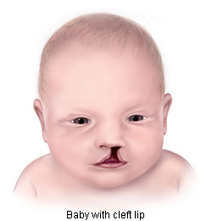
Cleft Lip
Notes:
Lips form at 4-7 weeks in utero
Surgery required to fix

Slide 10
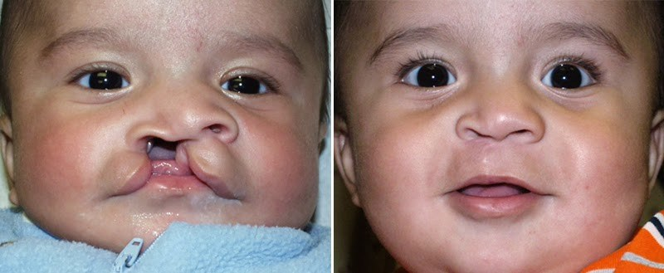
Cleft Palate
Notes:
Palate forms at 6-9 weeks in utero
Cleft palate happens when the palatal bones do not fuse properly
Corrected by surgeries and/or palatal guards

Slide 11
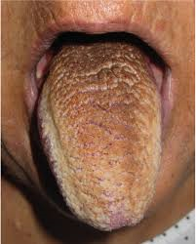
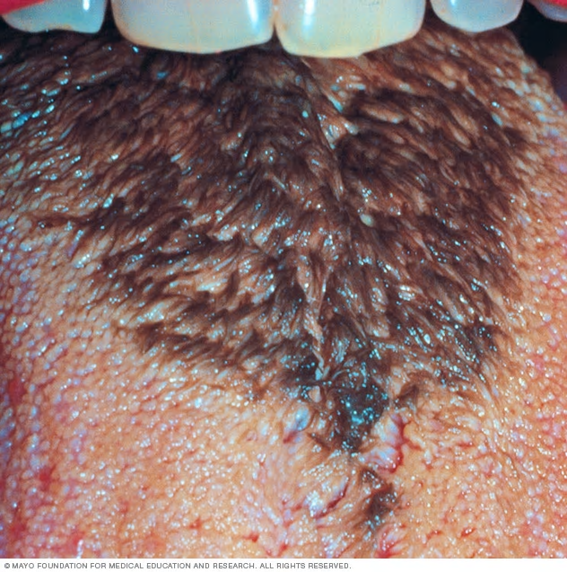
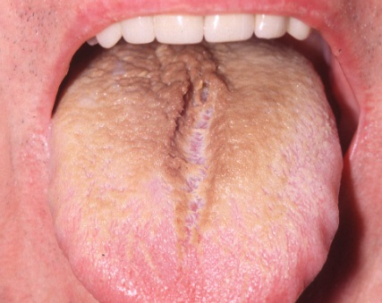
Hairy Tongue
Notes:
A black hairy tongue is caused by too much bacteria or yeast growth in the mouth. The bacteria build up on tiny rounded projections called papillae. These lie along the surface of the tongue. Instead of shedding as they normally do, the papillae start to grow and lengthen, creating hair-like projections

Slide 12
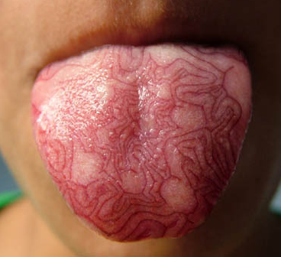
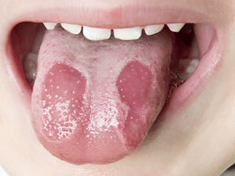
Geographical tongue
Notes:
Geographic tongue is an inflammatory but harmless condition
Patches on the surface of the tongue are missing papillae and appear as smooth, red "islands," often with slightly raised borders
Patches/lesions give the tongue a map like, or geographic, appearance
Lesions often heal in one area and then move to a different part of your tongue
Can sometimes cause tongue discomfort and increased sensitivity to certain substances, such as spices, salt and even sweets

Slide 13
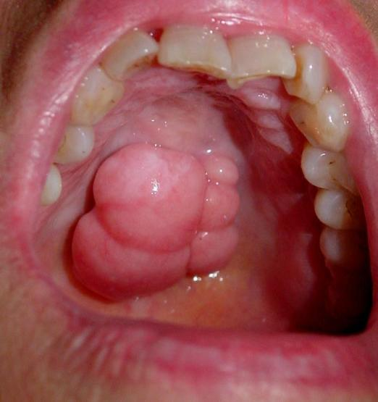
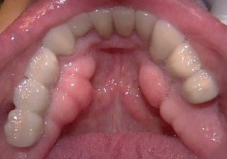
Tori & Exostosis (extra Bone)
TORI
EXOSTOSIS

Slide 14
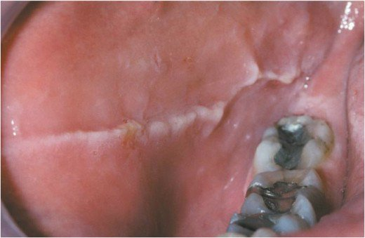
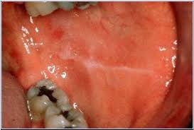
Linea ALba
Notes:
Caused by continuously biting/clinching your cheek

Slide 15
Questions?

