Slide 1
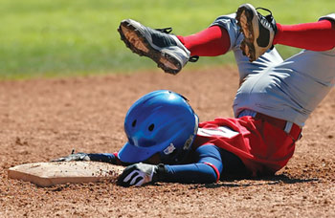
What’s Crackin’
Common Dental Injuries and Problems
By: Sally Wiedeman, EPDH, MBA

Slide 2
What is a dental injury?
Dental Trauma (injury): refers to trauma or injury to teeth, gums, and/or soft tissue (lips, cheek, tongue)
5 classifications:
Tooth and/or root injuries
Periodontal (gum) injuries
Injuries to supporting bone
Soft tissue laceration
Primary teeth

Slide 3
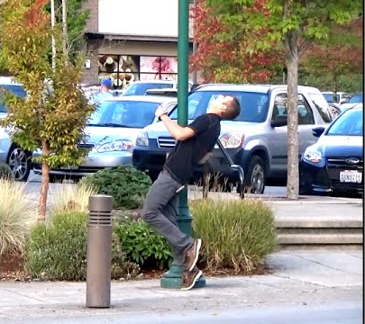
Causes
Falling
Running into something
Being hit with an object
Crashing on a bike
Car accident
Biting/Grinding/Clinching

Slide 4
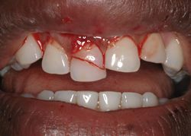
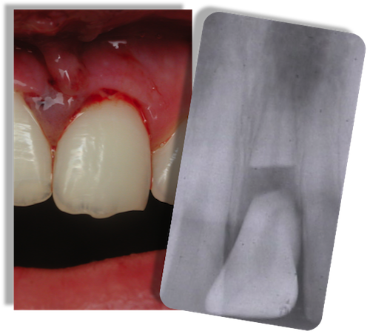
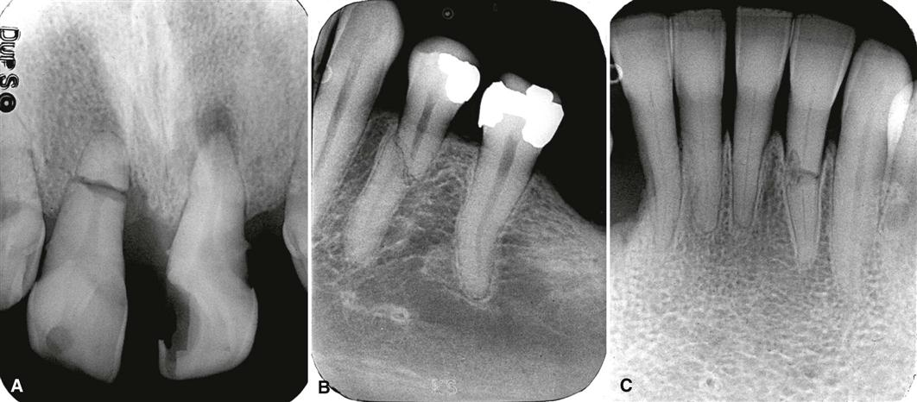
Tooth or Root Injuries

Slide 5
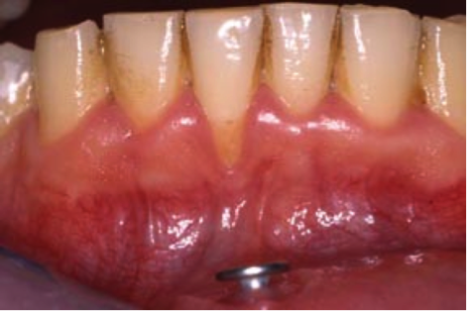
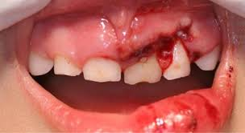
Periodontal Injuries

Slide 6
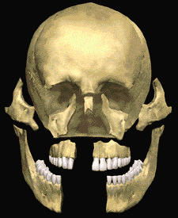
Supporting Bone Injuries
https://images.app.goo.gl/hQpXQqsmzQRXVPo87

Slide 7
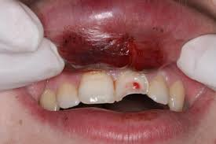
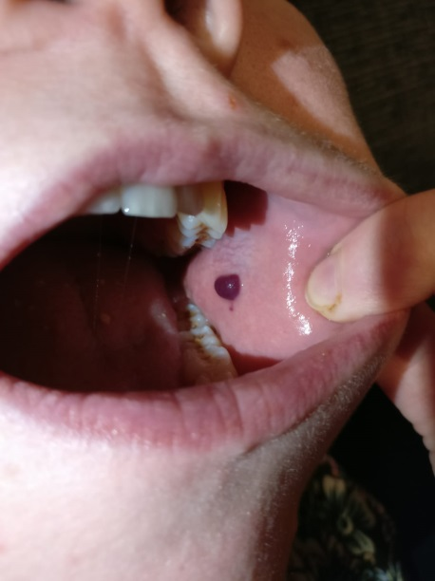
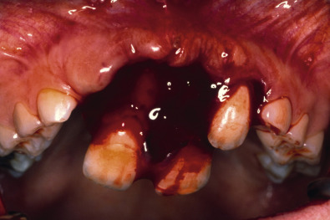
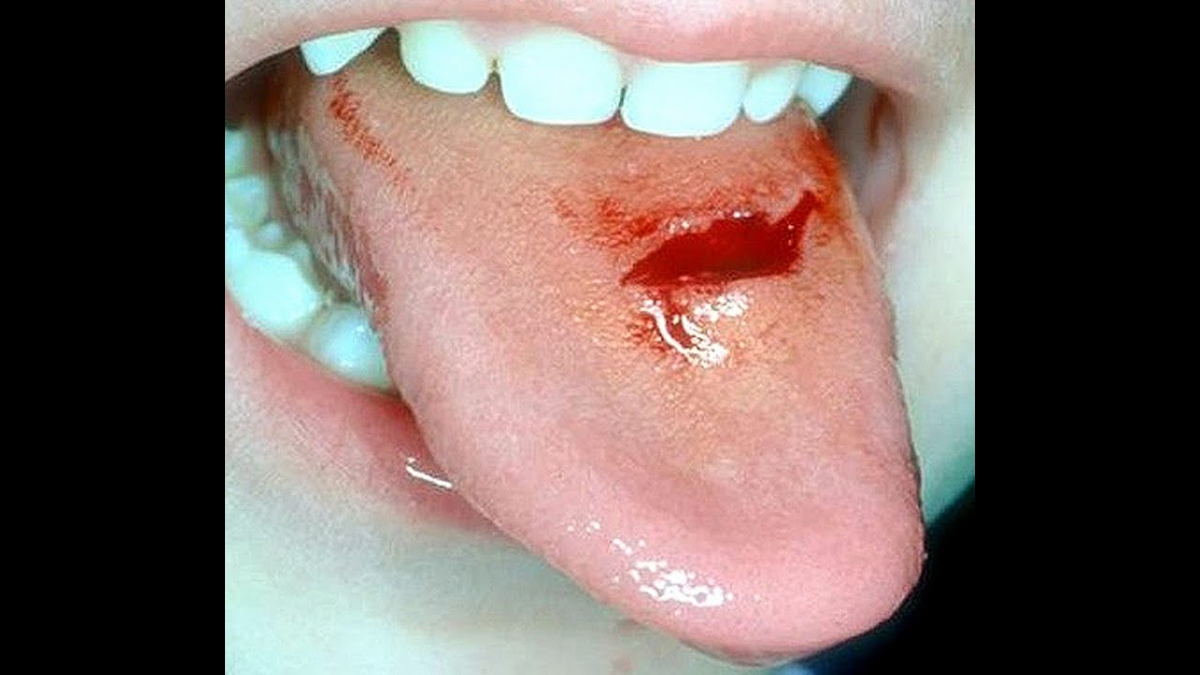
Soft Tissue Injuries

Slide 8
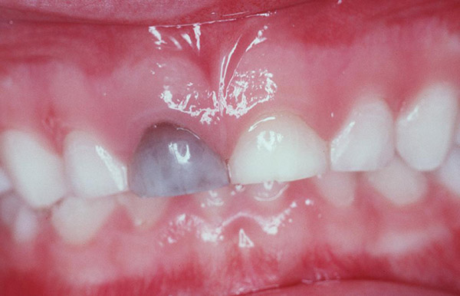
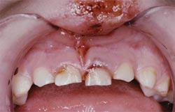
Primary Tooth Injuries

Slide 9
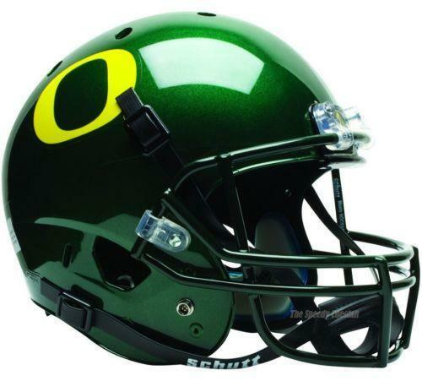
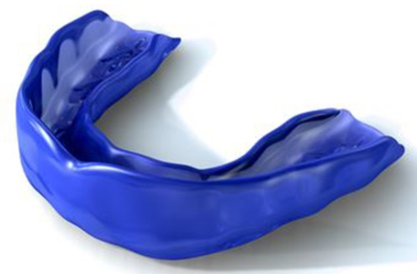
Prevention
Mouth Guards
Face Mask/Helmet
Being aware of your surroundings
www.youtube.com/watch?v=rMFQUVytgyw

Slide 10
Questions

