Slide 1
Baby Teeth and Baby Health
Signs, Symptoms, and Prevention
of Tooth Decay
By: Sally Wiedeman, EPDH, MBA

Slide 2
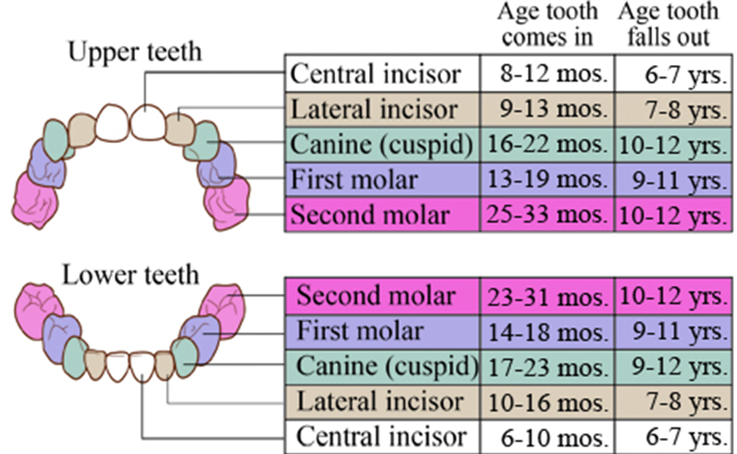
Eruption of Primary/Baby Teeth
*AI/AN children develop teeth earlier*

Slide 3
Eruption of Permanent Teeth

Slide 4
Mixed Dentition

Slide 5
Why we need healthy baby teeth
Space holder and act as a guide for erupting adult teeth
Aid in chewing
Provide structure for our face
Aid in speech patterns
Improves self-esteem

Slide 6
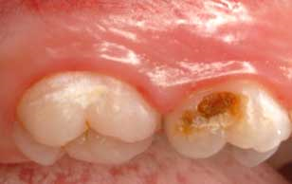
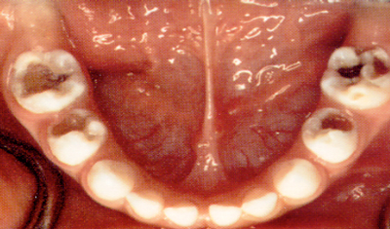
What can decay look like?

Slide 7
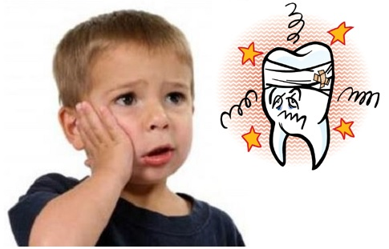
Signs & Symptoms
Tooth ache
Sensitivity
Yellow or brown spots on the teeth

Slide 8
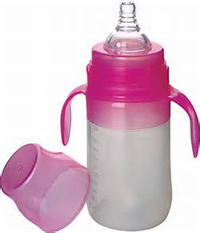
Causes
Bacteria in our saliva
Can be transferred from person to person
Sugar/Starches
Found in breastmilk
Poor oral hygiene
Acid reaction

Slide 9
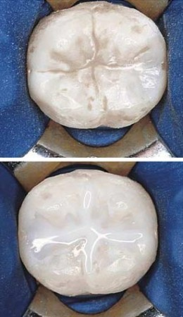
Prevention
Proper oral hygiene
Brushing daily
Flossing daily
Wiping mouth out after a bottle or breastfeeding
Drink water before bedtime
Regular screenings/check-ups with the dentist
Reduced sugar/starch diet
Sealants
Education

Slide 10
Questions?

