Slide 1
What’s that smell?
Importance of routine oral hygiene care
By: Sally Wiedeman, EPDH, MBA

Slide 2
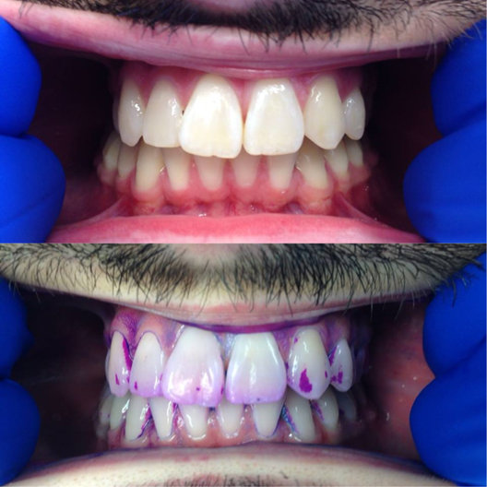
plaque
Soft sticky film that builds up on teeth
Contains millions of bacteria
Can cause decay or gum disease if left untreated
Requires proper brushing and flossing to remove

Slide 3
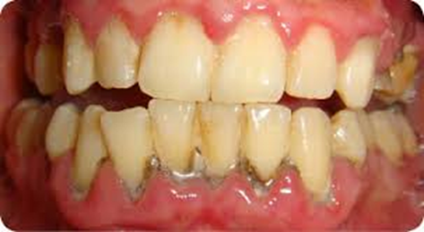
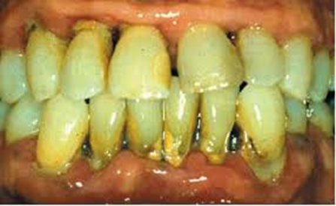
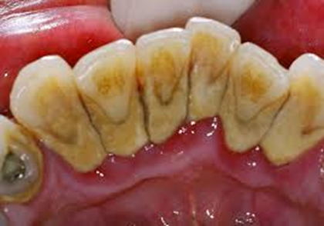
Calculus or tartAr
Form of hardened dental plaque
Cannot be removed with brushing or flossing, requires the use of dental instruments

Slide 4
What happens when plaque and calculus are left on the teeth?

Slide 5
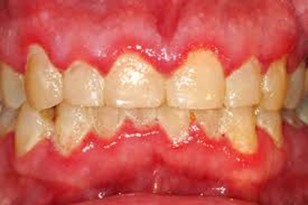
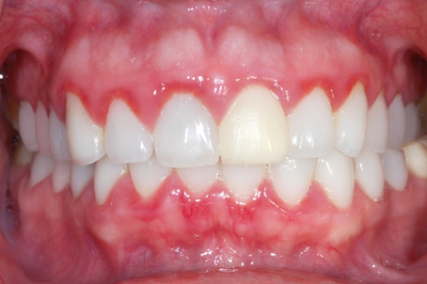
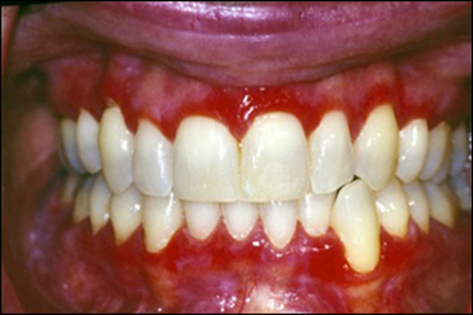
Gingivitis
Inflammation of the gums
MILD
SEVERE
MODERATE

Slide 6
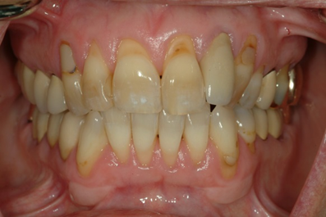
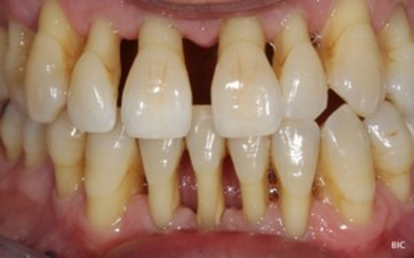
Recession
Gums move away from the crowns of the tooth and expose root of the tooth
more susceptible to decay and sensitivity

Slide 7
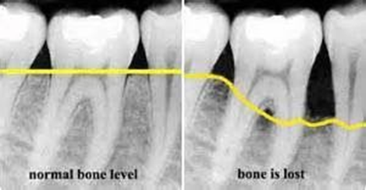
Periodontal or Gum Disease
Infection in the gums
causes bleeding
swelling
bone loss

Slide 8
Periodontal or Gum Disease
Untreated can lead to other systemic problems
Many people don't know they have gum disease. This is why it is important to see your dental team regularly for cleanings and checkups

Slide 9
Oral systemic link

Slide 10
Oral systemic link
Atherosclerosis
High levels of bacteria in the mouth can lead to clogged carotid arteries and stroke
Heart disease
2 times more like to develop heart disease and arterial narrowing
Plaque and bacteria enter the bloodstream through the gums
Respiratory problems
Bacteria from periodontal disease travels through the bloodstream to the lungs which can aggravate the respiratory system
Diabetes
95% of US adults with diabetes have periodontal disease
1/3 have advanced periodontal disease that has lead to tooth loss

Slide 11
What does these mean for patients
Routine dental exams and cleanings can prevent or significantly reduce bacterial infections that cause these problems
Improves oral health
Reduce or eliminate oral pain
Reduce the need for extractions
Reduce risk of heart attack, stroke and cancer
Opportunity to educate patients on oral hygiene

Slide 12
QUESTIONS?

