Slide 1
What did you say?
Breaking down dental lingo
By: Sally Wiedeman, EPDH, MBA

Slide 2
How many of you have ever been confused by the words used by the dentist or dental staff?

Slide 3
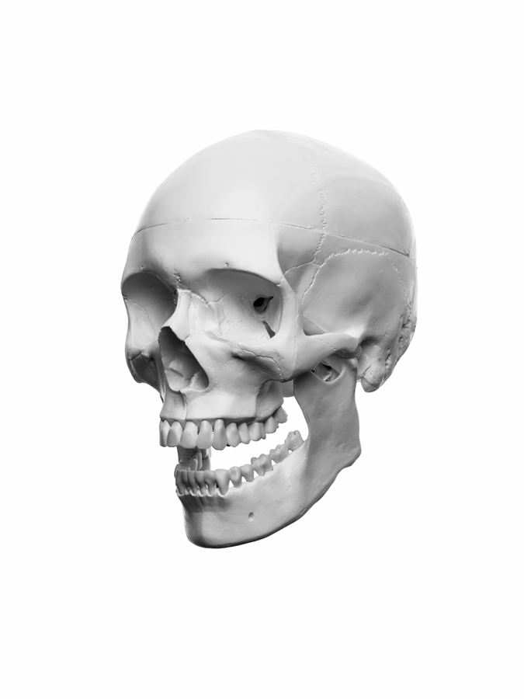
Dental Anatomy of the Face
Maxillary/Maxilla-upper jaw
Mandibular/Mandible-lower jaw
Temporal Mandibular Joint/TMJ-acts like a hinge to connect your lower jaw to your skull
Temporal Mandibular Dysfunction/TMD-pain and compromised movement of the joint and surrounding muscles
Midline-imaginary line that divides the body into right and left side; for the face and mouth we use the depression on the upper lip below the nose

Slide 4
Anatomy of a Tooth
Crown-portion of the tooth above the gums that we use to bite, tear, and chew with
Enamel-hard, outer surface layer of teeth that serves to protect against decay
Dentin-soft, layer under the enamel, that can cause sensitivity when exposed
Root-lower 2/3 of the tooth buried in the bone, used to anchor the tooth
Tooth Pulp-located under the dentin layer in a pulp chamber, contains nerves and blood vessels, it is what makes the tooth vital; when the pulp dies or is exposed a root canal is needed
Gingiva-gums/tissue that surrounds the bone

Slide 5
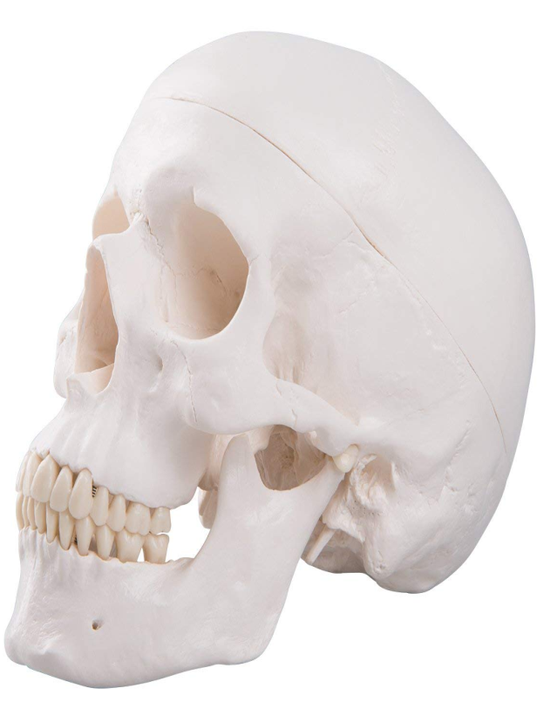
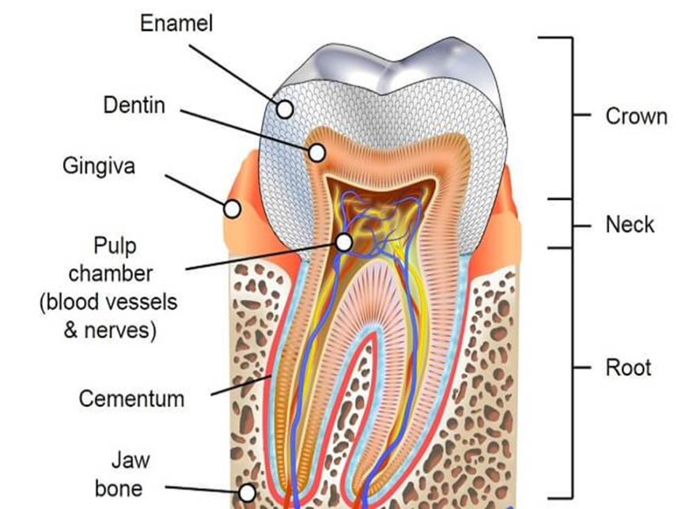
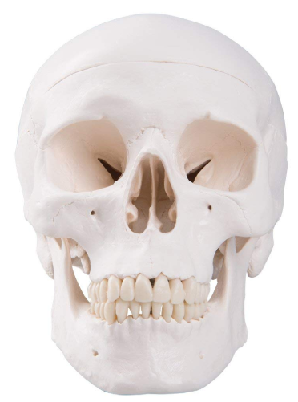
Anatomy
Maxillary/Maxilla
Temporal Mandibular Joint
TMJ
Maxillary/Maxilla
LEFT
Mandibular/Mandible
Temporal Mandibular Joint
TMJ
*Midline
Mandibular/Mandible
R
LL

Slide 6
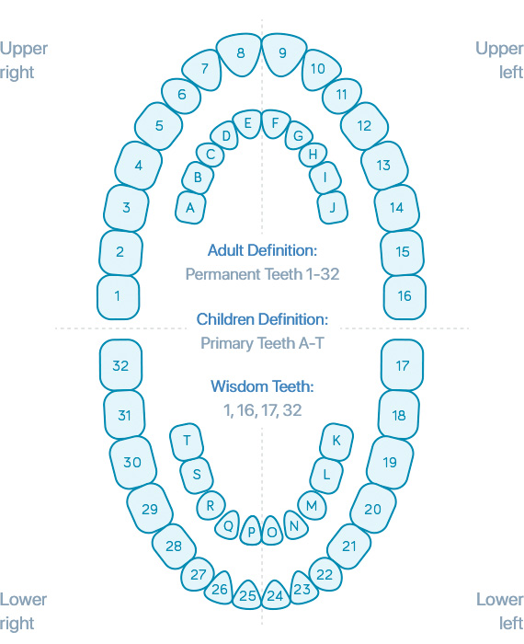
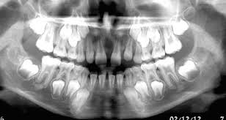
Tooth Identification
Primary (baby) teeth are letters A-T
Permanent (adult) teeth are numbers 1-32
Start on the upper right to the upper left then lower left to lower right

Slide 7
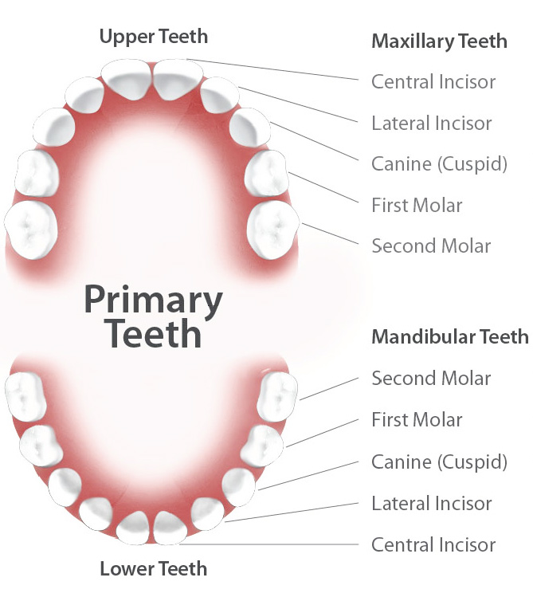
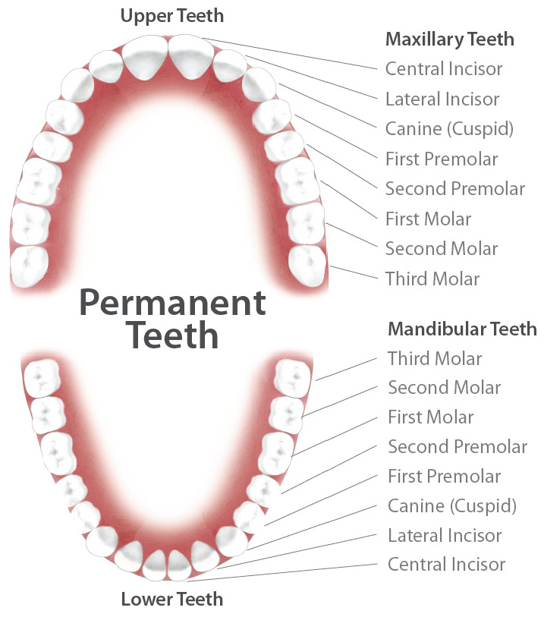
Types of Teeth
Molars
1st, 2nd, & 3rd (wisdom teeth)
Premolars
1st & 2nd
Incisors
Canines
Lateral
Central
*Children do not have premolars or wisdom teeth

Slide 8
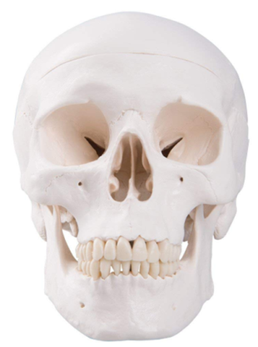
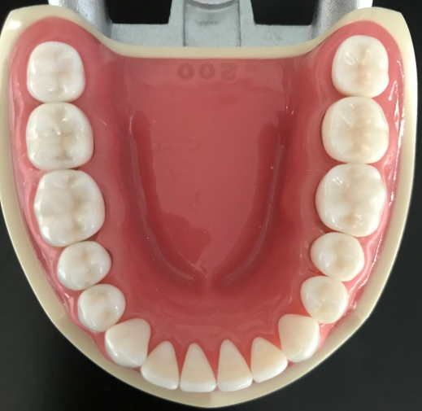
Tooth Surfaces
Mesial-side of the tooth toward the midline
Buccal or Facial-middle of the tooth that is facing the cheek/lip
Lingual-middle of the tooth that is facing the tongue or roof of the mouth (palate)
Distal-side of the tooth away from the midline
Occlusal or Incisal-the top or edge of the tooth
Facial
Distal
Distal
Lingual
B
U
C
C
A
L
O
O
Incisal
O
Lingual
O
Mesial
O
i
i
i
i
i
Occlusal
i
Mesial
Buccal
Facial

Slide 9
Restorations
**Fixed means the restoration is “locked” in place with cement, a screw, or bonding agent/material**
Composite or Resin-tooth colored filling
Alloy or Amalgam-silver filling (no, they do not contain enough mercury to poison you)
Crown or Cap-fixed restoration that encircles the tooth, can be made from gold, porcelain, zirconium, stainless steel, or a combination of metal and porcelain
Bridge-fixed restoration used to replace one or more missing teeth by joining an artificial tooth definitively to adjacent teeth
Implant-titanium screw surgically placed into the bone in the area of missing tooth/teeth to attach a crown, bridge, or denture

Slide 10
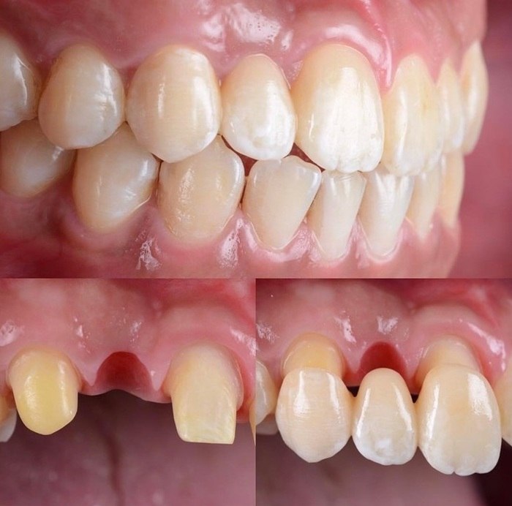
Restorations-Fixed
Alloy/Amalgam
Composite/Resin
Natural Tooth

Slide 11
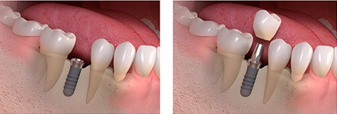
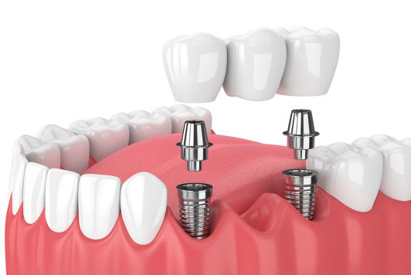
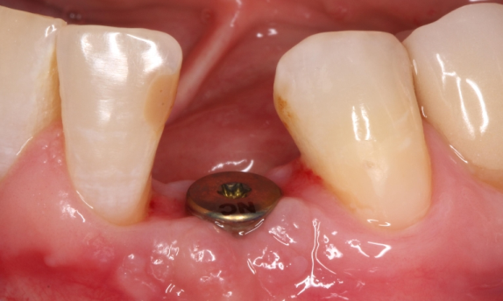
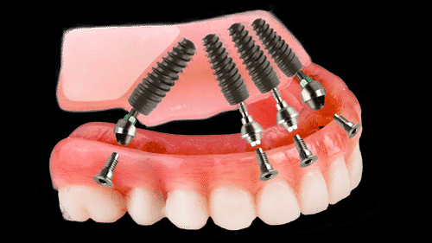
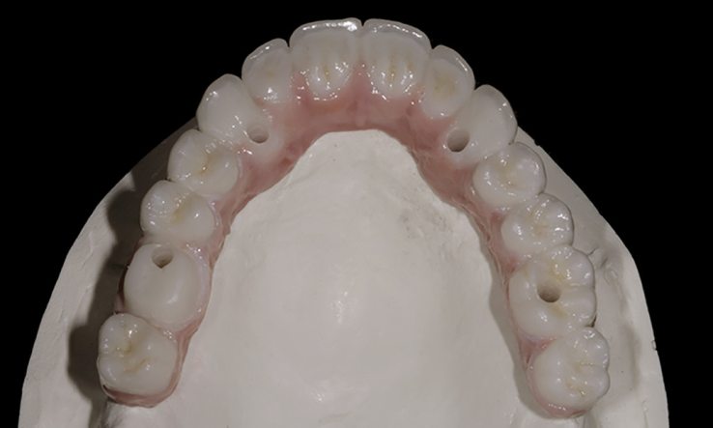
Restorations-Fixed
Crown
Abutment
Implant
Implant retained bridge
Healing cap
Screw hole
Implant retained denture

Slide 12
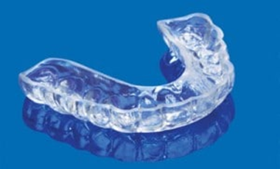
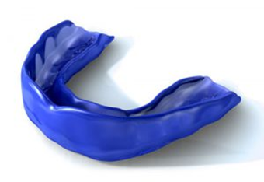
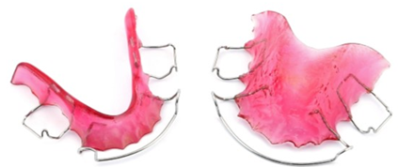
Removable Appliances
Dental appliance that can be taken in and out of the mouth
Dentures-standard or implant overdenture
Partial Dentures
Night guards
Athlete mouth guards
Orthodontic retainers
Orthodontic retainer
Night guard
Athletic mouth guard

Slide 13
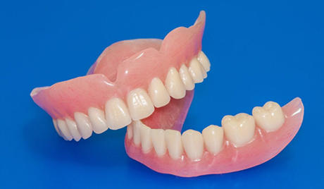
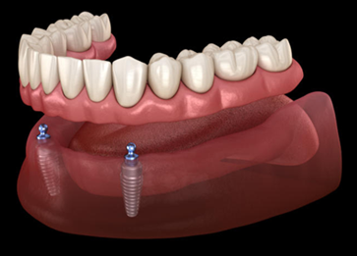
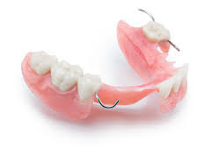
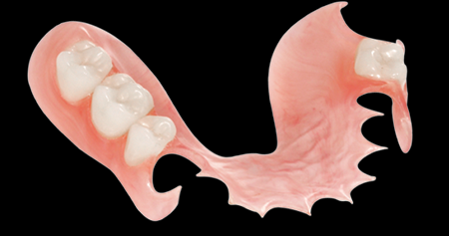
Removable Appliances
Traditional dentures
Implant overdenture
Metal frame partial
Acrylic w/metal clasp partial
Acrylic partial

Slide 14
Game Time!!
What is the name for a tooth colored filling?
Composite or resin
What is another name for the roof of your mouth?
Palate
What part of the tooth acts as an anchor?
Root
If the pulp is exposed or dies, what procedure can be done to make it better?
Root Canal
What surface of the tooth is toward the midline?
Mesial
Compromised jaw movement and pain could be a sign of?
TMD-Temporal Mandibular Dysfunction
What are the other terms for Baby and Adult teeth?
Primary and Permanent
Are primary/baby teeth identified as numbers or letters?
Letters
BONUS?
What are the letters?
A-T

Slide 15
QUESTIONS?

